Slide 1
Divide-and-Conquer Technique:
Merge Sort, Quick Sort

Slide 2
Divide-and-Conquer
Divide-and-Conquer is a general algorithm design paradigm:
  Divide the problem into a number of subproblems that are smaller instances of the same problem
  Conquer the subproblems by solving them recursively
  Combine the solutions to the subproblems into the solution for the original problem
The base case for the recursion are subproblems of constant size
Analysis can be done using recurrence equations

Slide 3
Merge Sort and Quick Sort
Two well-known sorting algorithms adopt this divide-and-conquer strategy
Merge sort
  Divide step is trivial – just split the list into two equal parts
  Work is carried out in the conquer step by merging two sorted lists
Quick sort
  Work is carried out in the divide step using a pivot element
  Conquer step is trivial

Slide 4
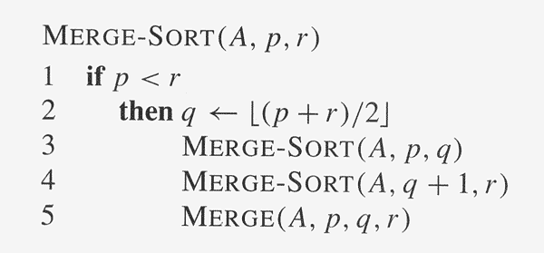
Merge Sort: Algorithm

Slide 5
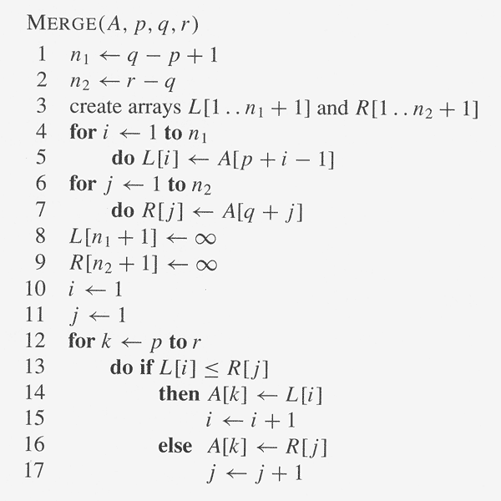
Merge Sort: Algorithm

Slide 6
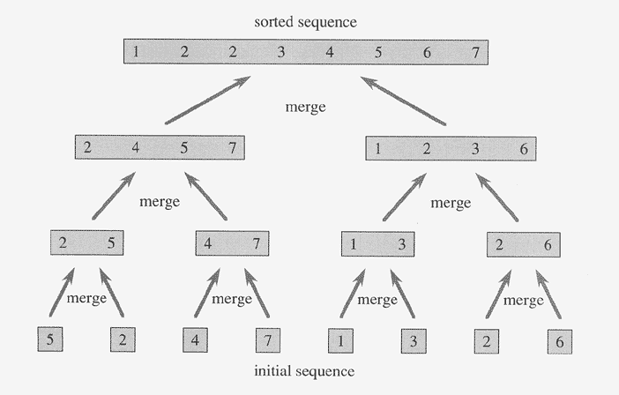
Merge Sort: Example

Slide 7
Execution Example
Partition
7 2 9 4 ⏐ 3 8 6 1 → 1 2 3 4 6 7 8 9
7 2 9 4 → 2 4 7 9
3 8 6 1 → 1 3 8 6
7 2 → 2 7
9 4 → 4 9
3 8 → 3 8
6 1 → 1 6
7 → 7
2 → 2
9 → 9
4 → 4
3 → 3
8 → 8
6 → 6
1 → 1
Merge Sort

Slide 8
Execution Example (cont.)
Recursive call, partition
7 2 9 4 ⏐ 3 8 6 1 → 1 2 3 4 6 7 8 9
7 2 ⏐ 9 4 → 2 4 7 9
3 8 6 1 → 1 3 8 6
7 2 → 2 7
9 4 → 4 9
3 8 → 3 8
6 1 → 1 6
7 → 7
2 → 2
9 → 9
4 → 4
3 → 3
8 → 8
6 → 6
1 → 1
Merge Sort

Slide 9
Execution Example (cont.)
Recursive call, partition
7 2 9 4 ⏐ 3 8 6 1 → 1 2 3 4 6 7 8 9
7 2 ⏐ 9 4 → 2 4 7 9
3 8 6 1 → 1 3 8 6
7 ⏐ 2 → 2 7
9 4 → 4 9
3 8 → 3 8
6 1 → 1 6
7 → 7
2 → 2
9 → 9
4 → 4
3 → 3
8 → 8
6 → 6
1 → 1
Merge Sort

Slide 10
Execution Example (cont.)
Recursive call, base case
7 2 9 4 ⏐ 3 8 6 1 → 1 2 3 4 6 7 8 9
7 2 ⏐ 9 4 → 2 4 7 9
3 8 6 1 → 1 3 8 6
7 ⏐ 2 → 2 7
9 4 → 4 9
3 8 → 3 8
6 1 → 1 6
7 → 7
2 → 2
9 → 9
4 → 4
3 → 3
8 → 8
6 → 6
1 → 1
Merge Sort

Slide 11
Execution Example (cont.)
Recursive call, base case
7 2 9 4 ⏐ 3 8 6 1 → 1 2 3 4 6 7 8 9
7 2 ⏐ 9 4 → 2 4 7 9
3 8 6 1 → 1 3 8 6
7 ⏐ 2 → 2 7
9 4 → 4 9
3 8 → 3 8
6 1 → 1 6
7 → 7
2 → 2
9 → 9
4 → 4
3 → 3
8 → 8
6 → 6
1 → 1
Merge Sort

Slide 12
Execution Example (cont.)
Merge
7 2 9 4 ⏐ 3 8 6 1 → 1 2 3 4 6 7 8 9
7 2 ⏐ 9 4 → 2 4 7 9
3 8 6 1 → 1 3 8 6
7 ⏐ 2 → 2 7
9 4 → 4 9
3 8 → 3 8
6 1 → 1 6
7 → 7
2 → 2
9 → 9
4 → 4
3 → 3
8 → 8
6 → 6
1 → 1
Merge Sort

Slide 13
Execution Example (cont.)
Recursive call, …, base case, merge
7 2 9 4 ⏐ 3 8 6 1 → 1 2 3 4 6 7 8 9
7 2 ⏐ 9 4 → 2 4 7 9
3 8 6 1 → 1 3 8 6
7 ⏐ 2 → 2 7
9 4 → 4 9
3 8 → 3 8
6 1 → 1 6
7 → 7
2 → 2
9 → 9
4 → 4
3 → 3
8 → 8
6 → 6
1 → 1
Merge Sort

Slide 14
Execution Example (cont.)
Merge
7 2 9 4 ⏐ 3 8 6 1 → 1 2 3 4 6 7 8 9
7 2 ⏐ 9 4 → 2 4 7 9
3 8 6 1 → 1 3 8 6
7 ⏐ 2 → 2 7
9 4 → 4 9
3 8 → 3 8
6 1 → 1 6
7 → 7
2 → 2
9 → 9
4 → 4
3 → 3
8 → 8
6 → 6
1 → 1
Merge Sort

Slide 15
Execution Example (cont.)
Recursive call, …, merge, merge
7 2 9 4 ⏐ 3 8 6 1 → 1 2 3 4 6 7 8 9
7 2 ⏐ 9 4 → 2 4 7 9
3 8 6 1 → 1 3 6 8
7 ⏐ 2 → 2 7
9 4 → 4 9
3 8 → 3 8
6 1 → 1 6
7 → 7
2 → 2
9 → 9
4 → 4
3 → 3
8 → 8
6 → 6
1 → 1
Merge Sort

Slide 16
Execution Example (cont.)
Merge
7 2 9 4 ⏐ 3 8 6 1 → 1 2 3 4 6 7 8 9
7 2 ⏐ 9 4 → 2 4 7 9
3 8 6 1 → 1 3 6 8
7 ⏐ 2 → 2 7
9 4 → 4 9
3 8 → 3 8
6 1 → 1 6
7 → 7
2 → 2
9 → 9
4 → 4
3 → 3
8 → 8
6 → 6
1 → 1
Merge Sort

Slide 17
Merge Sort: Running Time
The recurrence for the worst-case running time T(n) is
T(n) = Θ(1) if n = 1
2T(n/2) + Θ(n) if n > 1
equivalently
T(n) = c if n = 1
2T(n/2) + cn if n > 1
Solve this recurrence by
(1) iteratively expansion
(2) using the recursion tree

Slide 18
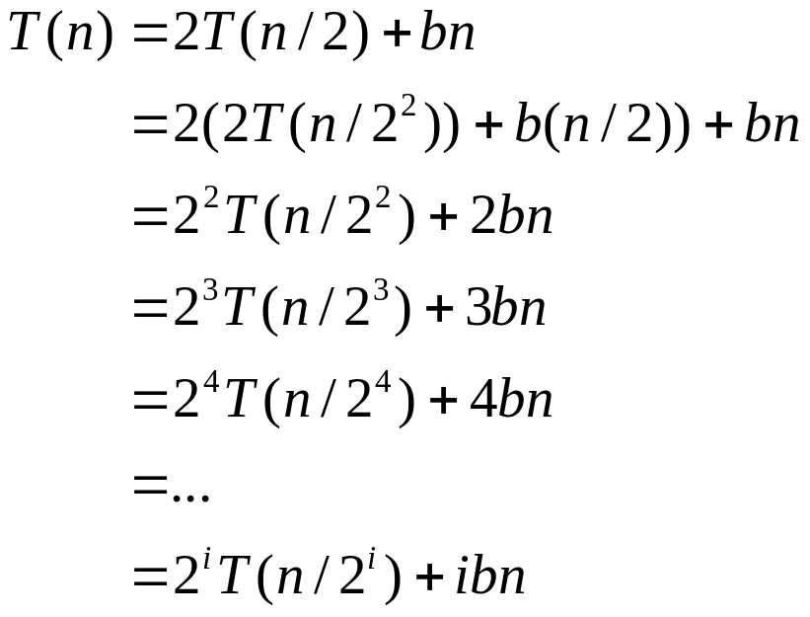

Merge Sort: Running Time (Iterative Expansion)
Note that base, T(n) =b, case occurs when 2^{i} = n.
That is, i = log n.
So,
Thus, T(n) is O(n log n).

Slide 19
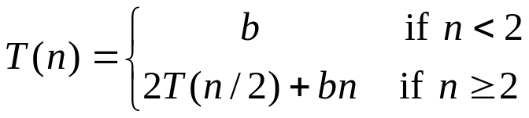
Merge Sort: Running Time (Recursion Tree)
Draw the recursion tree for the recurrence relation and look for a pattern:
depth | T’s | size
0 | 1 | n
1 | 2 | n/2
i | 2^{i} | n/2^{i}
… | … | …
time
bn
bn
bn
…
Total time = bn + bn log n
(last level plus all previous levels)

Slide 20
Quick Sort: Algorithm
Another divide-and-conquer algorithm
  The array A[p..r] is partitioned into two non-empty subarrays A[p..q] and A[q+1..r]
    Invariant: All elements in A[p..q] are less than all elements in A[q+1..r]
  The subarrays are recursively sorted by calls to quicksort
  Unlike merge sort, no combining step: two subarrays form an already-sorted array

Slide 21
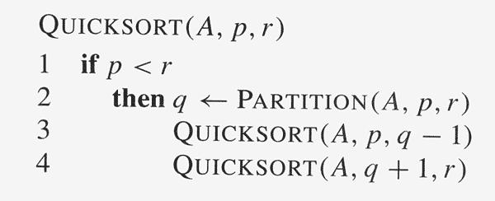
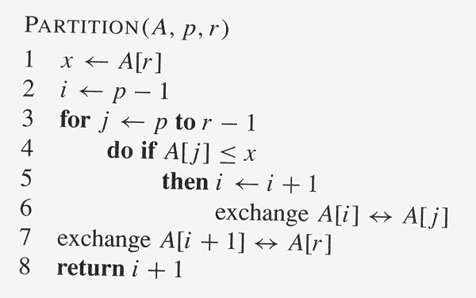
Quick Sort: Algorithm

Slide 22
Quick Sort: Algorithm (Partition)
Clearly, all the actions take place in the partition() function
  Rearranges the subarrays in place
  End result:
    Two subarrays
    All values in first subarray ≤ all values in the second
  Returns the index of the “pivot” element separating the two subarrays

Slide 23
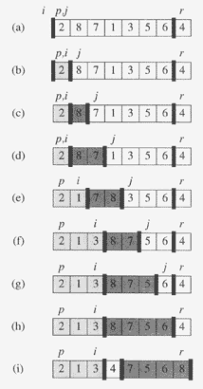
Quick Sort: Algorithm
pivot
From i +1 to j is a window of elements > A[r]. The cursor j moves right one step at a time.
If the cursor j “discovers” an element ≤ A[r], then this element is swapped with the front element of the window, effectively moving the window right one step; if it discovers an element > A[r], then the window simply becomes longer one unit.

Slide 24
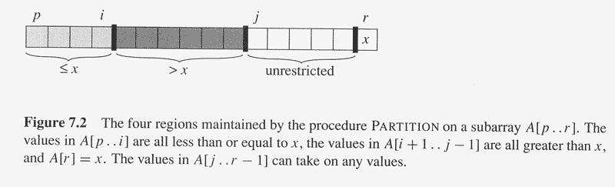
Quick Sort: Algorithm

Slide 25
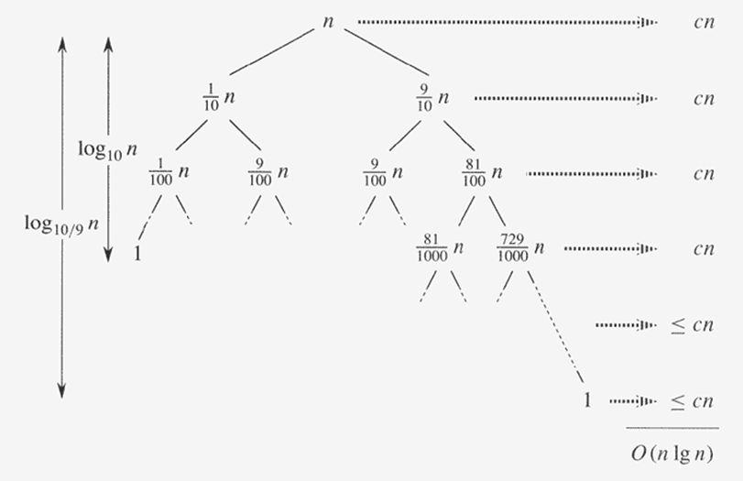
Quick Sort: Analysis

